Slide 1
Agenda
Dynamic Network Gephi
Graph building
Extracting Seeds from the large graph
Procurement and Travel channels
Extracted graphs

Slide 2
Dynamic Network in Gephi
Graph over time
Interactive
Notes:
Interactive
Filter
Time
Color, size, edge color
Graph Measurements: from number of nodes and edges to graph density, PageRank and so on
Comparing graphs
Layout

Slide 3
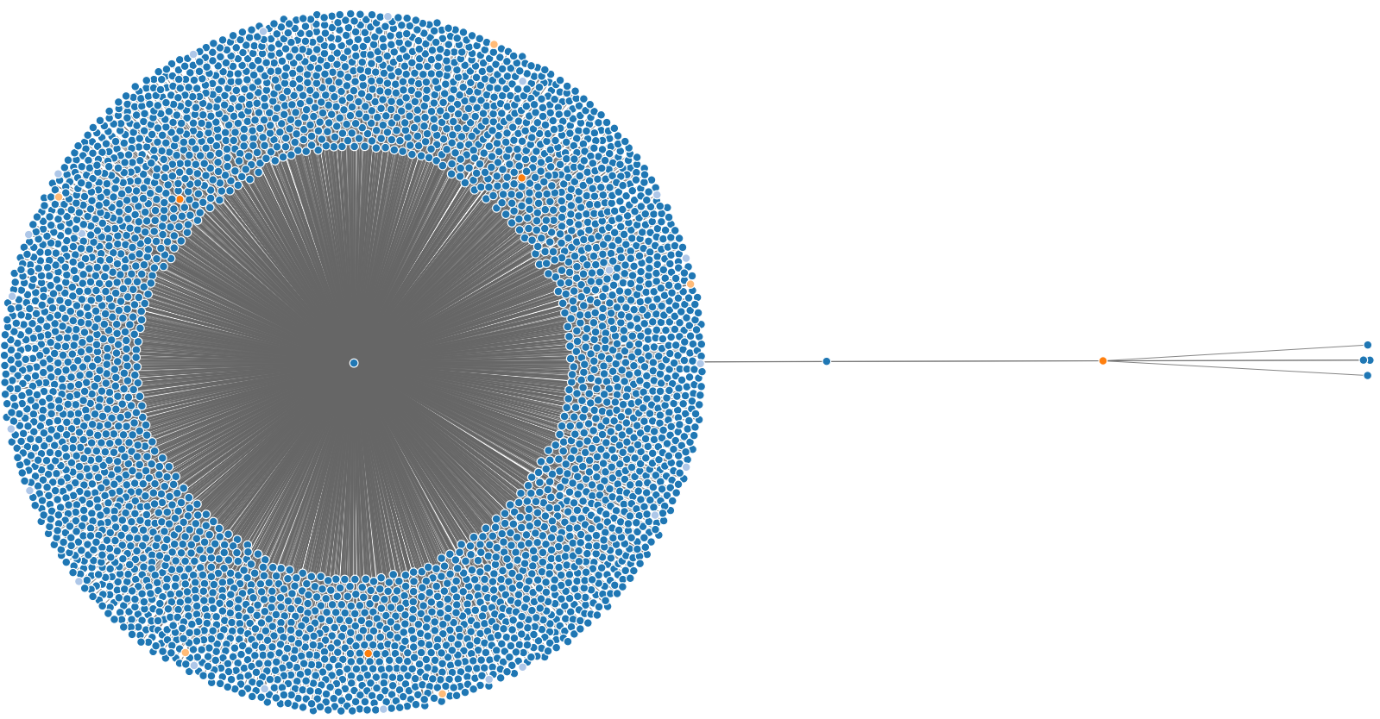
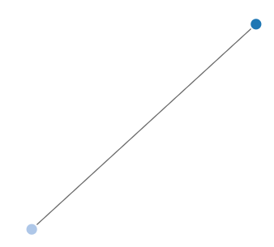
Graph Building 1
Step 2:
Finding directly connected
nodes
Step 1:
Locating the Seed

Slide 4
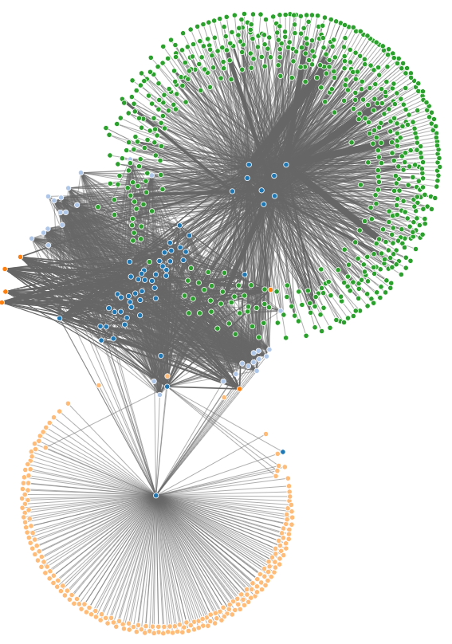
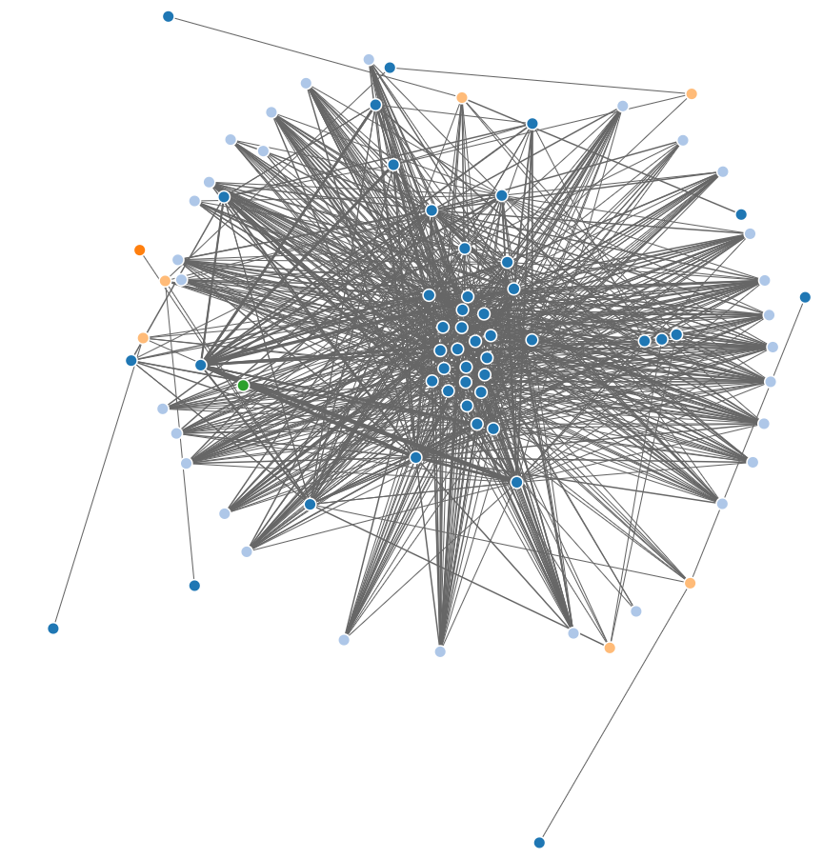
Graph Building 2
Step 3:
Accumulating the
prominent nodes
Step 4:
Finalizing the network

Slide 5
Graph building 3
Notes:
Seeds
Four major steps to create graphs
Step 1: Locating the Seed
Step 2: Finding directly connected nodes
Step 3: Accumulating the prominent nodes
Step 4: Finalizing the network.

Slide 6
Extracting Seeds from the large graph
Channel Visualization and analysis
Choosing appropriate channels

Slide 7
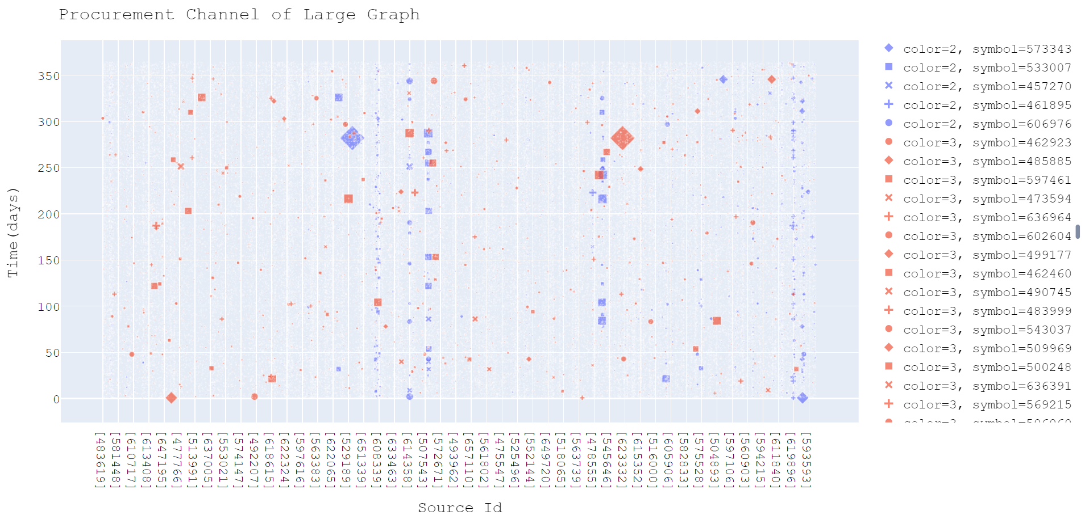
Procurement Channel

Slide 8
Travel channel

Slide 9
Filtering the Seeds
Many clusters from travel channel from the large graph
Few node pairs from Procurement
Finding the travel channel for the pairs
Comparing the travel clusters with the pairs travel channel
Creating the graphs

Slide 10
Reference
[1] ARC DIAGRAM. url: https://www.data-to-viz.com/graph/arc.html.
[2] Sven Bachthaler and Daniel Weiskopf. “Continuous scatterplots". In: IEEE transactions on visualization and computer graphics 14.6 (2008), pp. 1428-1435.
[3] David A Bader et al. “Approximating betweenness centrality". In: International Workshop on Algorithms and Models for the Web-Graph. Springer. 2007, pp. 124-137.
[4] Mathieu Bastian, Sebastien Heymann, Mathieu Jacomy, et al. “Gephi: an open source software for exploring and manipulating networks." In: Icwsm 8.2009 (2009), pp. 361-362.
[5] Ekaba Bisong. “Google Colaboratory". In: Building Machine Learning and Deep Learning Models on Google Cloud Platform. Springer, 2019, pp. 59-64.
[6] Phillip Bonacich. “Some unique properties of eigenvector centrality". In: Social networks 29.4 (2007), pp. 555-564.
[7] Ulrik Brandes, Linton C. Freeman, and Dorothea Wagner. “Social networks". In: Handbook of graph drawing and visualization. Ed. by Roberto Tamassia. London: Chapman Hall, 2010, pp. 805{839. ISBN: 978-1-58488-412-5.
[8] Brian Fisher. “Illuminating the Path: An RD Agenda for Visual Analytics". In: Jan. 2005, pp. 69-104. ISBN: 0769523234.
[9] Julian Heinrich and Daniel Weiskopf. “Continuous parallel coordinates". In: IEEE Transactions on Visualization and Computer Graphics 15.6 (2009), pp. 1531-1538.
[10] Jimmy Johansson et al. “Perceiving patterns in parallel coordinates: determining thresholds for identification of relationships". In: Information Visualization 7.2 (2008), pp. 152-162.
[11] Daniel Keim et al. “Visual Analytics: Definition, Process, and Challenges". In: (Mar. 2008). DOI: 10.1007/978-3-540-70956-5_7.

Slide 11
Reference
[12] Till Nagel and Erik Duval. “A visual survey of arc diagrams". In: IEEE Visualization. 2013.
[13] Kazuya Okamoto, Wei Chen, and Xiang-Yang Li. “Ranking of closeness centrality for large-scale social networks". In: International workshop on frontiers in algorithmics. Springer. 2008, pp. 186-195.
[14] Edward L Platt. Network Science with Python and NetworkX Quick Start Guide: Explore and Visualize Network Data Effectively. Packt Publishing Ltd, 2019.
[15] R library ff: Memory-Efficient Storage of Large Data on Disk and Fast Access Functions. url: https://cran.r-project.org/web/packages/ff/index.html.
[16] Filippo Santambrogio. “Optimal Transport for Applied Mathematicians. Calculus of Variations, PDEs and Modeling". In: (2015). url: https://www.math.u-psud.fr/~filippo/OTAM-cvgmt.pdf.
[17] Mohammed Zuhair Al-Taie and Seifedine Kadry. Python for graph and network analysis. Springer, 2017.
[18] Matteo Togninalli et al. “Wasserstein Weisfeiler{Lehman Graph Kernels". In: Advances in Neural Information Processing Systems 32 (NeurIPS). Ed. by H.Wallach et al. Curran Associates, Inc., 2019, pp. 6436-6446.
[19] Two Sample Testing Based on The 2-Wasserstein Distance. url: https://www.bioconductor.org/packages/devel/bioc/vignettes/waddR/inst/doc/wasserstein_test.html.
[20] VAST Challenge data description. url: https://vast-challenge.github.io/2020/MC1.html.
[21] Matthew O Ward, Georges Grinstein, and Daniel Keim. Interactive data visualization: foundations, techniques, and applications. CRC Press, 2010.
[22] Dmitry Zinoviev. Complex network analysis in Python: Recognize-constructvisualize-analyze-interpret. Pragmatic Bookshelf, 2018.

